Slide 1
Final Project (2020)
Algorithm of Beetle Swarm Antennae Search (BSAS), Beetle Swarm Optimization (BSO) for Continuous Optimization Problems
R08546002
劉晏誠
January 18, 2021

Slide 2
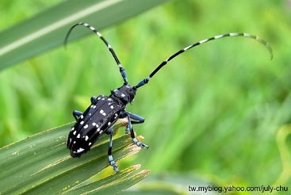
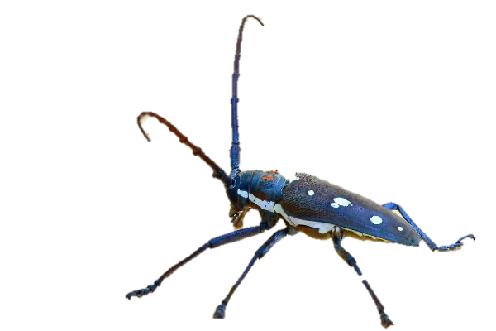
Outline
Introduction
System & UI Design
Demo
Implement & Result
Conclusion

Slide 3

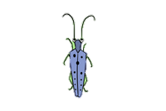
Introduction
Beetle Antennae Search algorithm (BAS)
模仿天牛在找尋食物的行為，哪邊的觸角氣味濃度高就往哪飛。
BSAS & BSO
right < left
Target
right > left
right > left
right > left
BSAS | BSO
針對BAS缺點進行改善的演算法。 K個隨機方向向量取代1隻天牛。 針對更新兩觸角直徑及移動距離訂定一套機制。 | 結合BAS & PSO的演算法。 K個初始位置取代1隻天牛。 比BSAS使用更多參數，修改更新參數的公式。

Slide 4
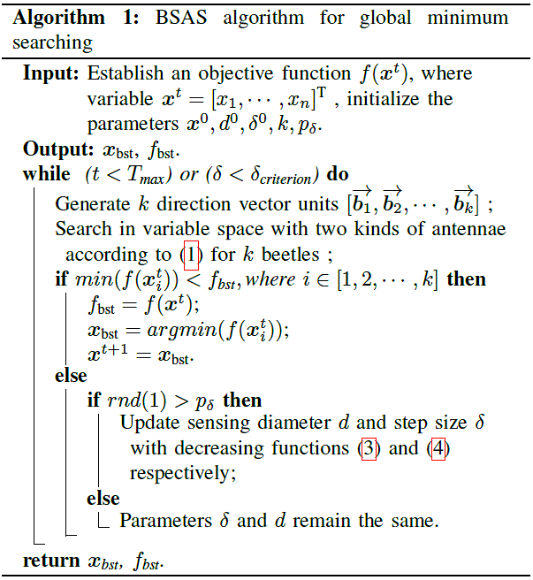
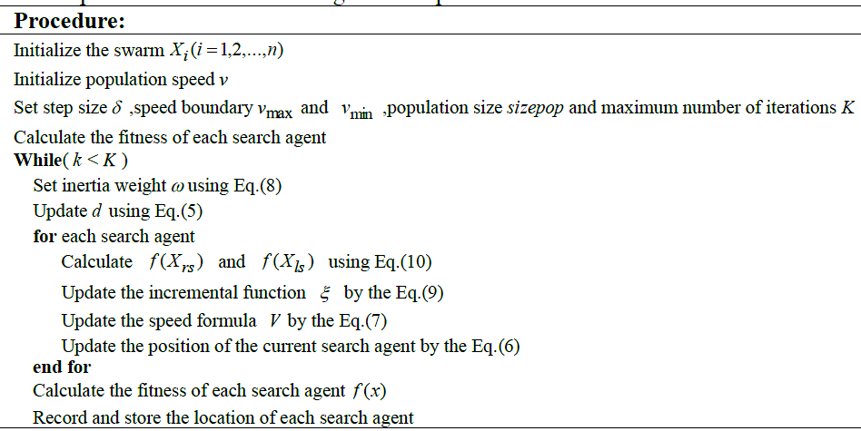
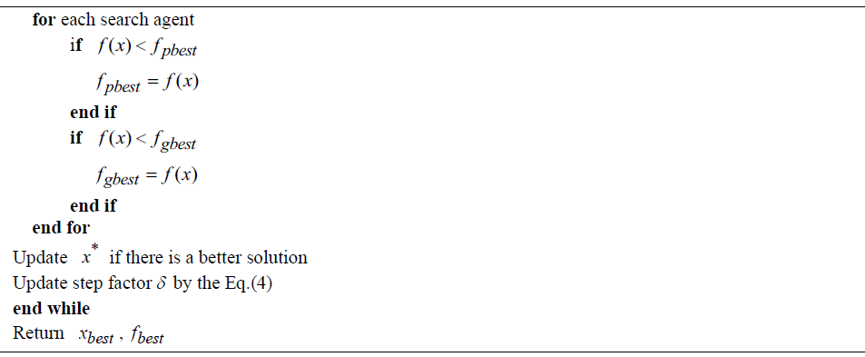
Introduction-Pseudo Code
BSAS
BSO
Notes:
藍底是產生k個Beetle的方式 BSAS是只有1個初始位置然後產生K個隨機方向向量，BSO是一開始就有K個初始位置，跟PSO一樣
紅框是更新參數的步驟

Slide 5
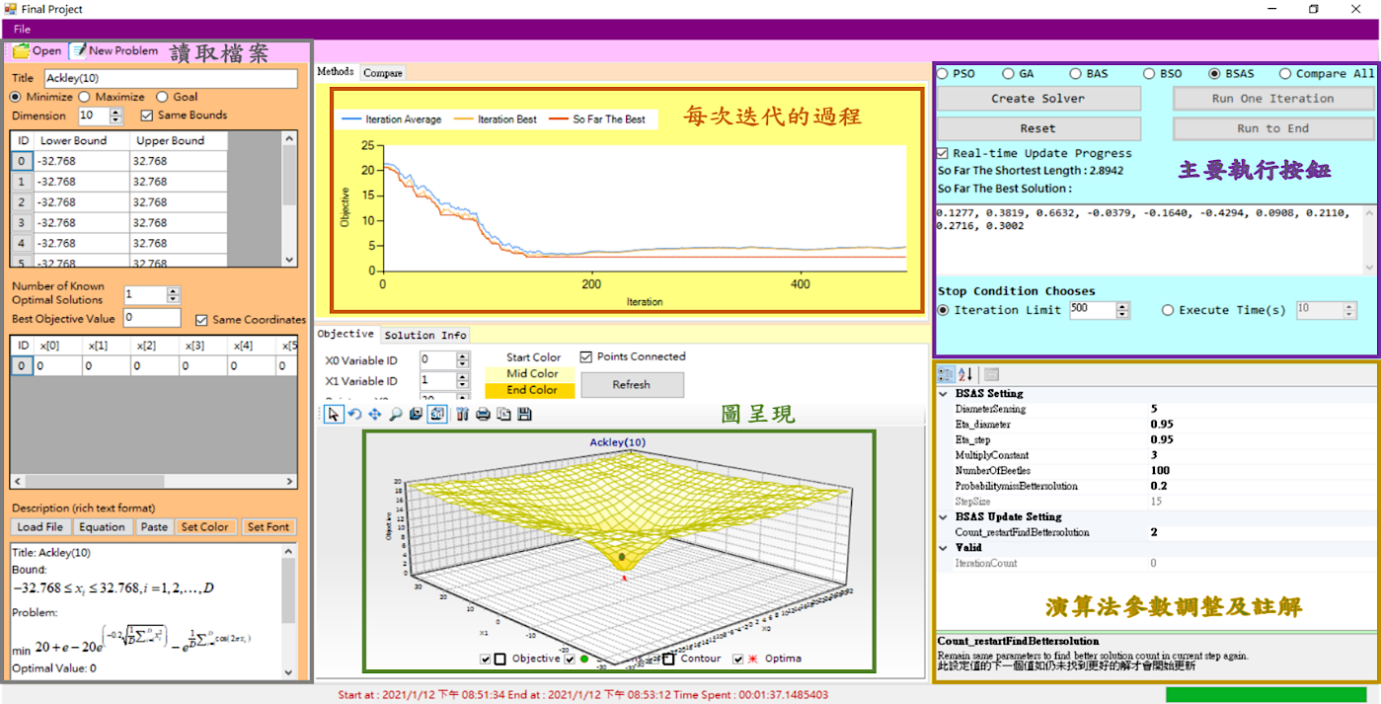
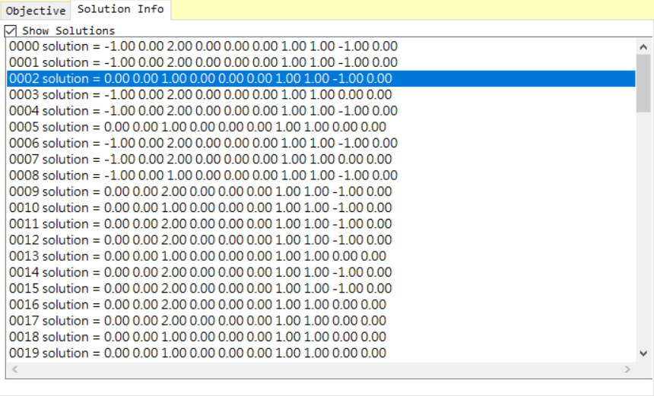
System & UI Design (1)

Slide 6
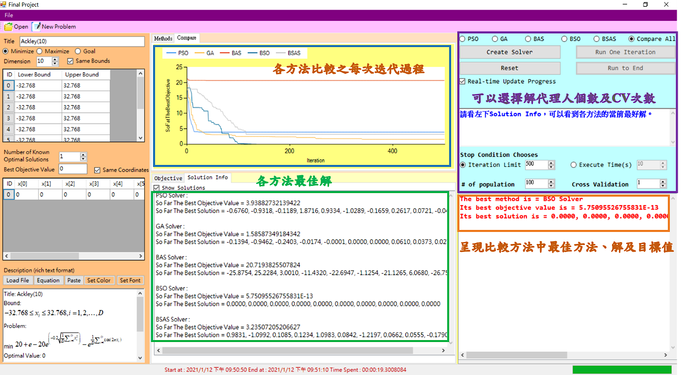
System & UI Design (2)

Slide 7
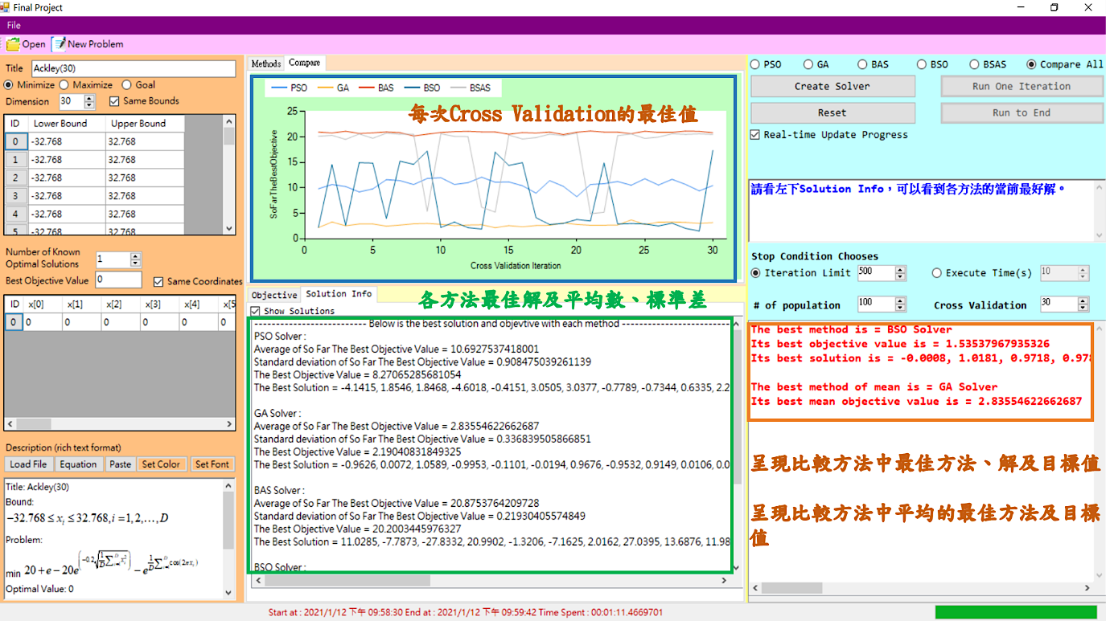
System & UI Design (3)
CV=30

Slide 8
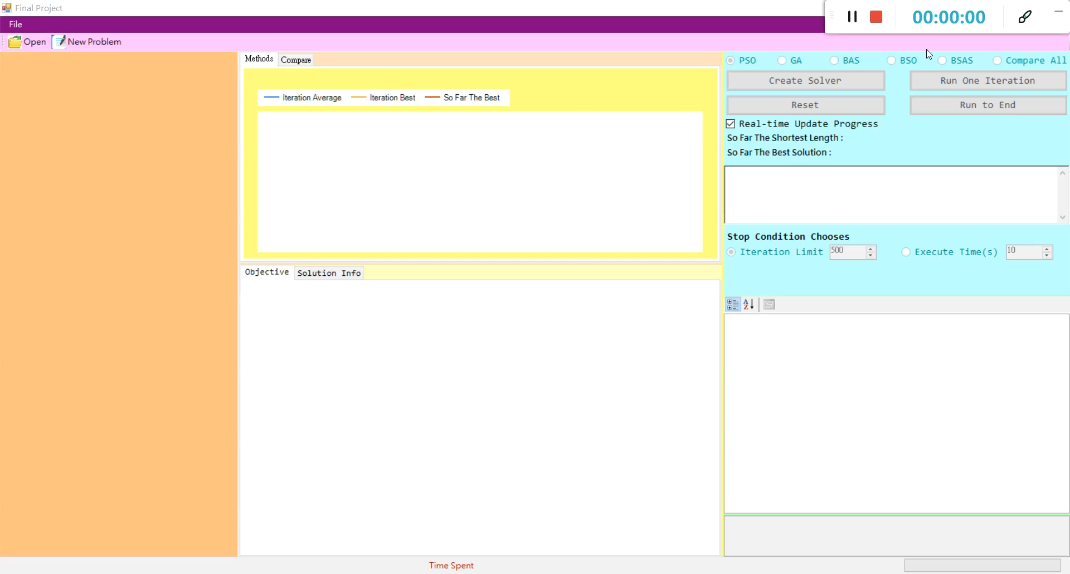
Demo

Slide 9
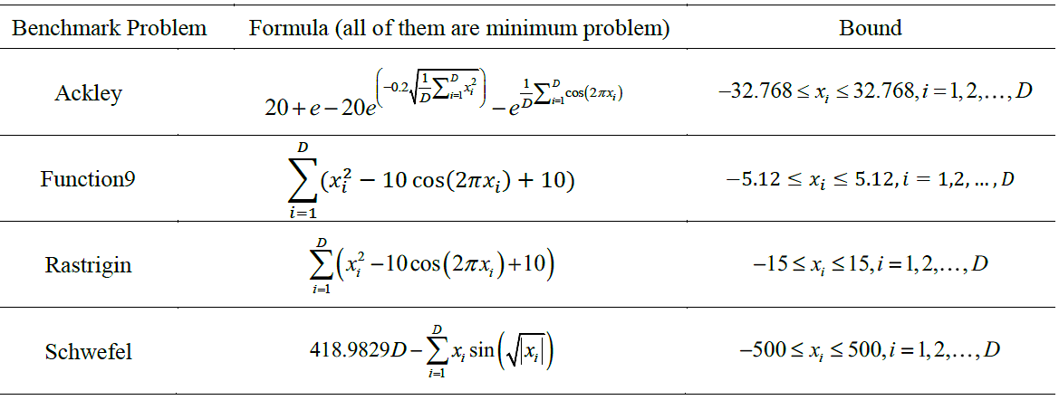
Implement & Result
四個標竿問題 : Ackley、Girewank、Schwefel、Function9
三個維度 : 2D、10D、30D
參數定義
Iteration Limit = 500，解代理人個數 = 100, CV = 30

Slide 10
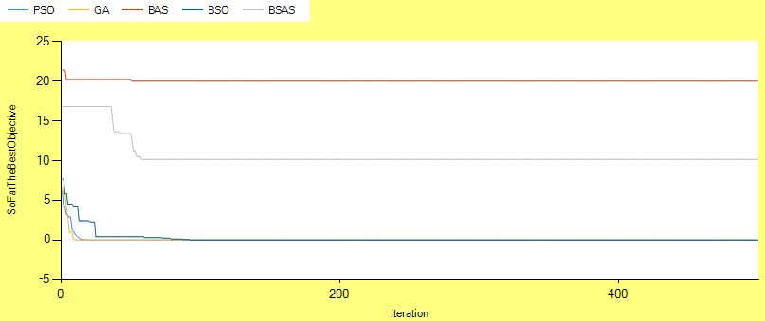
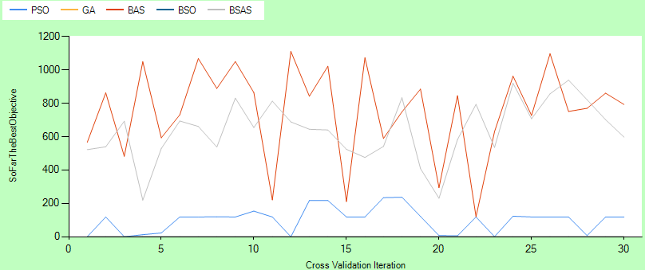
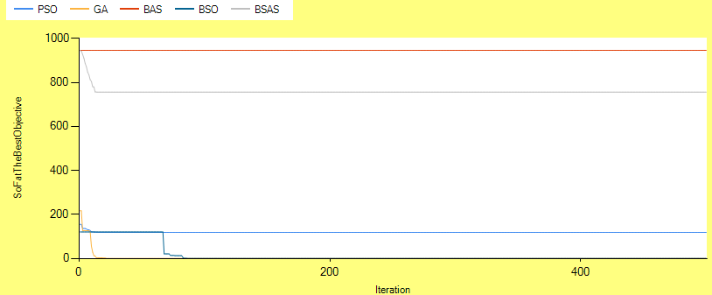
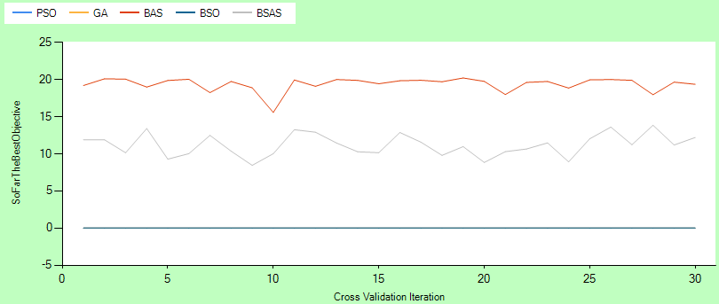
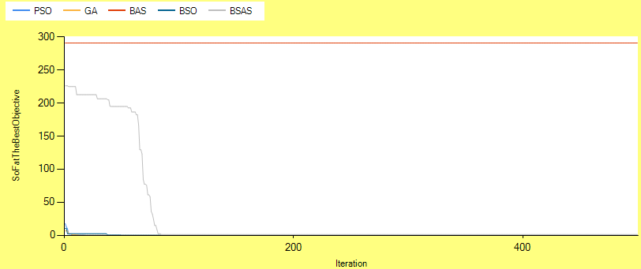
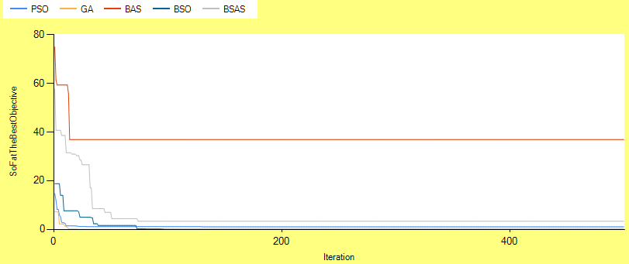
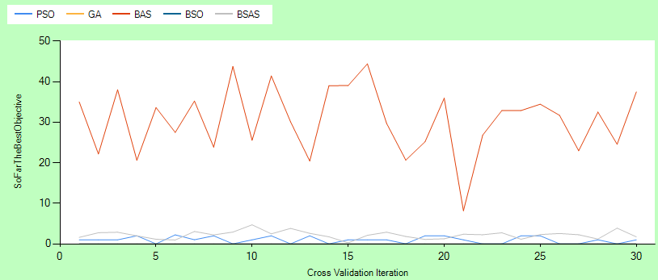
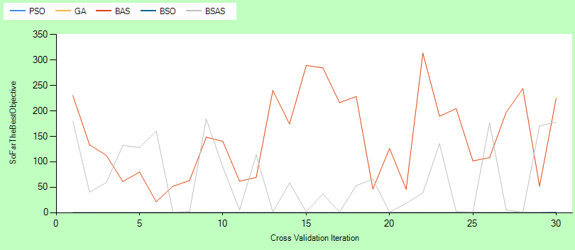
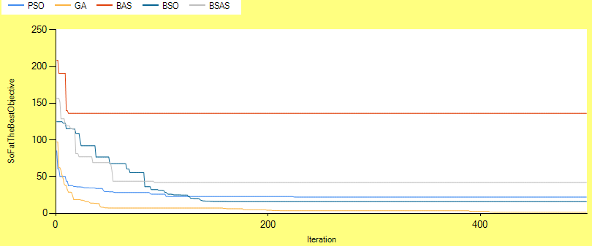
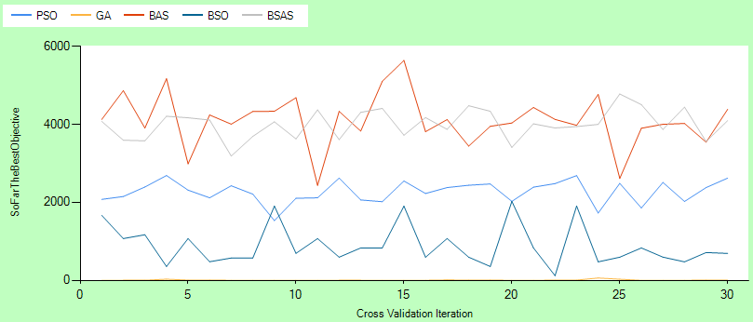
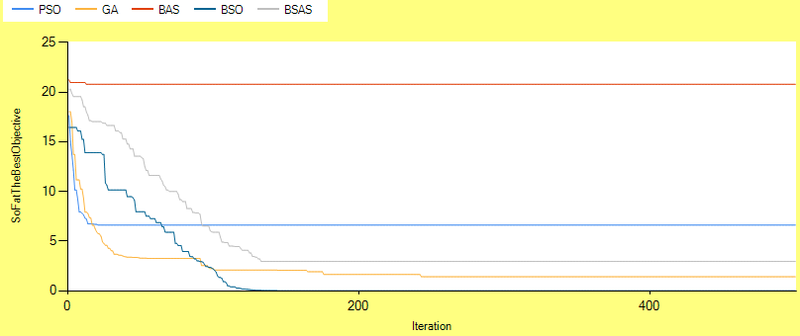
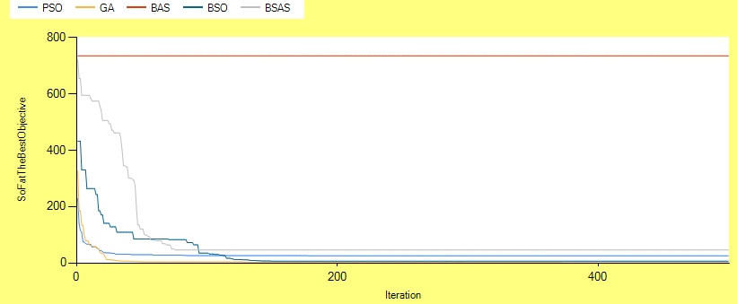
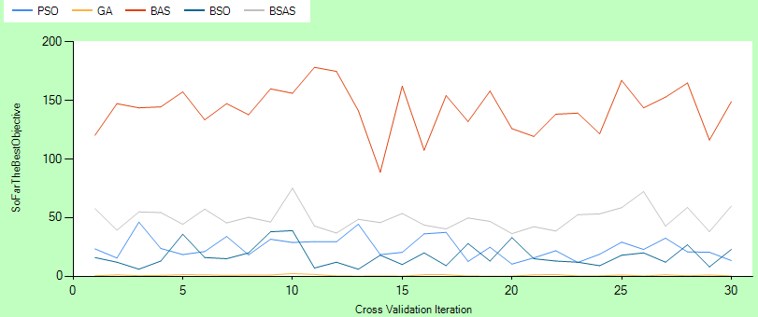
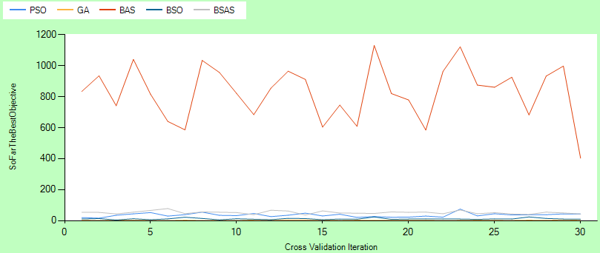
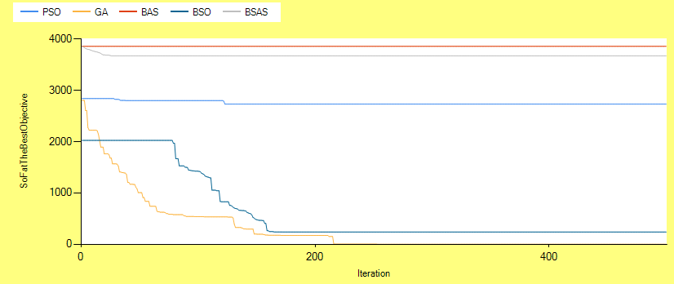
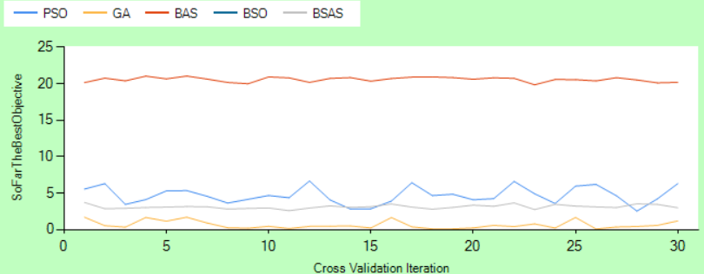
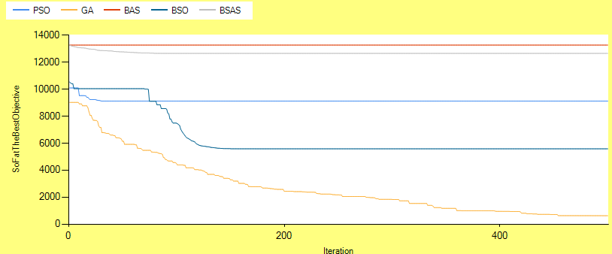
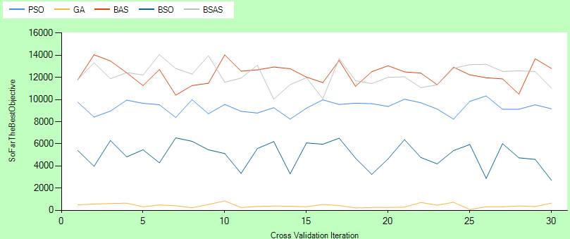
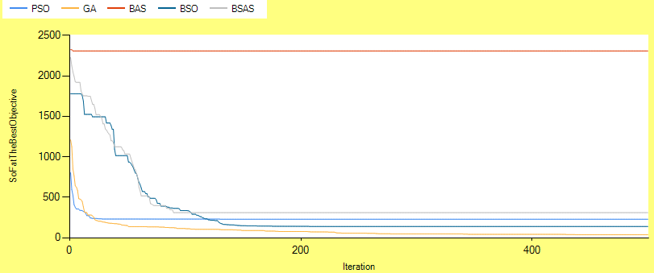
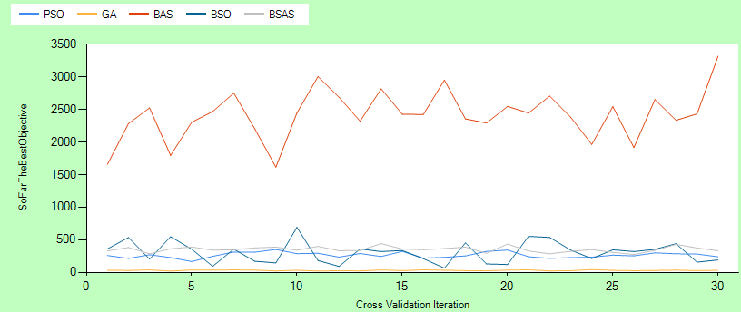
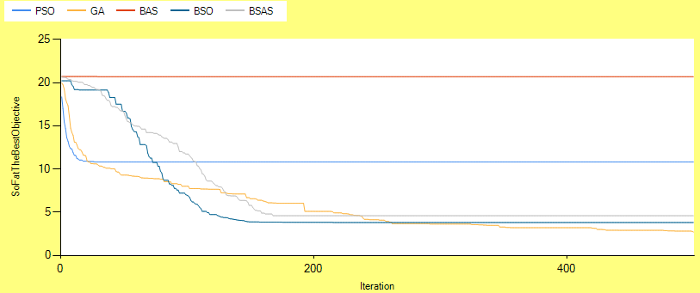
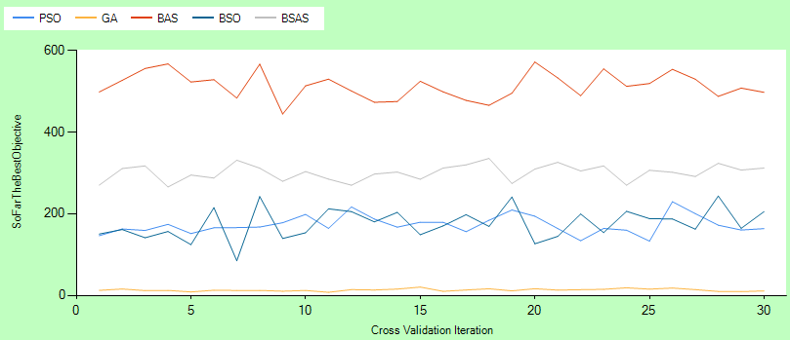
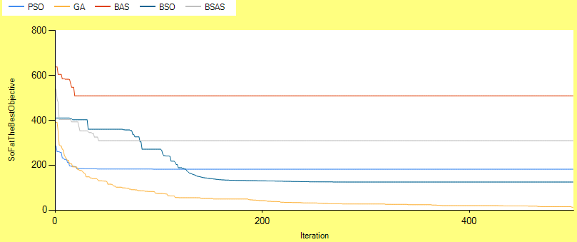
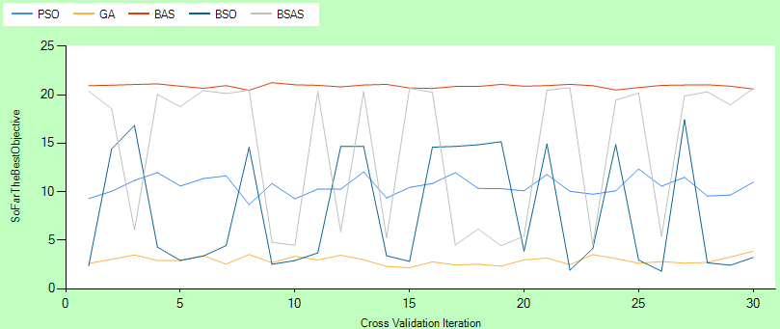
Implement & Result
CV = 1
CV = 30
2D
10D
30D
Rastrigin
Function9
Ackely
Schwefel

Slide 11
Implement & Result
 |  |  | PSO | GA | BAS | BSO | BSAS
Ackely | 2D | Mean | 1.05E-10 | 2.56E-06 | 19.3913 | -4.44E-16 | 11.1851
 |  | Std | 5.45E-10 | 1.38E-05 | 0.9309 | 0 | 1.490
 |  | Best | -4.44E-16 | -4.44E-16 | 15.579 | -4.44E-16 | 8.4489
 | 10D | Mean | 4.8109 | 0.5973 | 20.6963 | 0.0385 | 3.6941
 |  | Std | 7.984 | 0.4434 | 0.3202 | 0.2074 | 4.4568
 |  | Best | 3.2722 | 0.0602 | 19.7705 | 3.11E-15 | 2.5989
 | 30D | Mean | 10.5669 | 2.9153 | 20.8957 | 7.9094 | 14.5928
 |  | Std | 0.9348 | 0.4209 | 0.1836 | 5.9565 | 7.1977
 |  | Best | 8.6746 | 2.1557 | 20.4636 | 1.8002 | 4.4207
Function9 | 3D | Mean | 0.9722 | 0.0019 | 30.5167 | 0 | 2.2189
 |  | Std | 0.8002 | 0.0039 | 8.0191 | 0 | 0.9401
 |  | Best | 1.77E-15 | 0 | 8.1671 | 0 | 0.2514
 | 10D | Mean | 24.3423 | 0.7391 | 142.7730 | 17.3857 | 49.5181
 |  | Std | 9.0601 | 0.5678 | 19.9150 | 9.2406 | 9.4662
 |  | Best | 10.3492 | 0.0345 | 88.7945 | 5.9698 | 36.3088
 | 30D | Mean | 172.9453 | 13.1603 | 513.7311 | 175.9694 | 300.8913
 |  | Std | 21.9199 | 2.9822 | 31.9697 | 36.9762 | 19.0829
 |  | Best | 133.0789 | 7.5881 | 444.5825 | 84.8890 | 265.7669
在Ackely的標竿問題中，BSO在2D、10D表現最好，GA在30D表現最好
在Function9的標竿問題中，BSO在2D表現最好，GA在10D、30D表現最好

Slide 12
Implement & Result
 |  |  | PSO | GA | BAS | BSO | BSAS
Rastrigin | 2D | Mean | 0.0332 | 8.02E-10 | 148.7067 | 0 | 68.0336
 |  | Std | 0.1786 | 4.3213 | 83.6188 | 0 | 67.5938
 |  | Best | 0 | 0 | 21.3585 | 0 | 1.0092
 | 10D | Mean | 35.6589 | 2.5044 | 828.4719 | 11.1436 | 52.2245
 |  | Std | 12.2054 | 1.3105 | 171.4318 | 4.8019 | 9.5046
 |  | Best | 15.6126 | 0.4105 | 402.8278 | 3.9798 | 35.9136
 | 30D | Mean | 263.3152 | 29.7678 | 2419.047 | 304.7676 | 351.5660
 |  | Std | 42.2239 | 6.1768 | 372.2679 | 160.1292 | 42.3915
 |  | Best | 165.0287 | 19.0971 | 1614.734 | 63.7944 | 272.9127
Schwefel | 2D | Mean | 100.6269 | 0.0001 | 757.0797 | 2.55E-05 | 637.8798
 |  | Std | 71.3839 | 0.0005 | 270.5582 | 0 | 173.5709
 |  | Best | 3.52E-05 | 2.55E-05 | 120.2398 | 2.55E-05 | 219.2132
 | 10D | Mean | 2269.847 | 6.2571 | 4105.837 | 888.3357 | 4005.609
 |  | Std | 279.5655 | 12.1219 | 672.1639 | 504.8425 | 364.9250
 |  | Best | 1532.856 | 0.0160 | 2436.484 | 118.4385 | 3188.595
 | 30D | Mean | 9324.374 | 420.1990 | 12327.53 | 5022.552 | 12196.33
 |  | Std | 549.7999 | 174.9897 | 936.6405 | 1120.350 | 983.8486
 |  | Best | 8231.627 | 60.7323 | 10396.05 | 2693.144 | 10033.41
在Rastrigin的標竿問題中，BSO在2D表現最好，GA在10D、30D表現最好
在Schwefel的標竿問題中，BSO在2D表現最好，GA在10D、30D表現最好

Slide 13
Conclusion
BAS相較於其他演算法，其在各標竿問題下表現最差。
BSAS及BSO此兩種方法維度越高，每次所得到的最佳解越不穩定。
BSO適合使用於低維度的問題，而GA適合使用於中、高為度的問題。
綜觀來看，GA > BSO > PSO > BSAS > BAS。

Slide 14
Reference
Jiang, X., & Li, S. Bas: Beetle antennae search algorithm for optimization problems. arXiv preprint arXiv:1807.10724.
Wang, J., & Chen, H. (2018). BSAS: Beetle swarm antennae search algorithm for optimization problems. arXiv preprint arXiv:1807.10470.
Wang, T., Yang, L., & Liu, Q. (2018). Beetle swarm optimization algorithm: Theory and application. arXiv preprint arXiv:1808.00206.

Slide 15
THE END
Institute of Industrial Engineering, NTU

